Slide 1
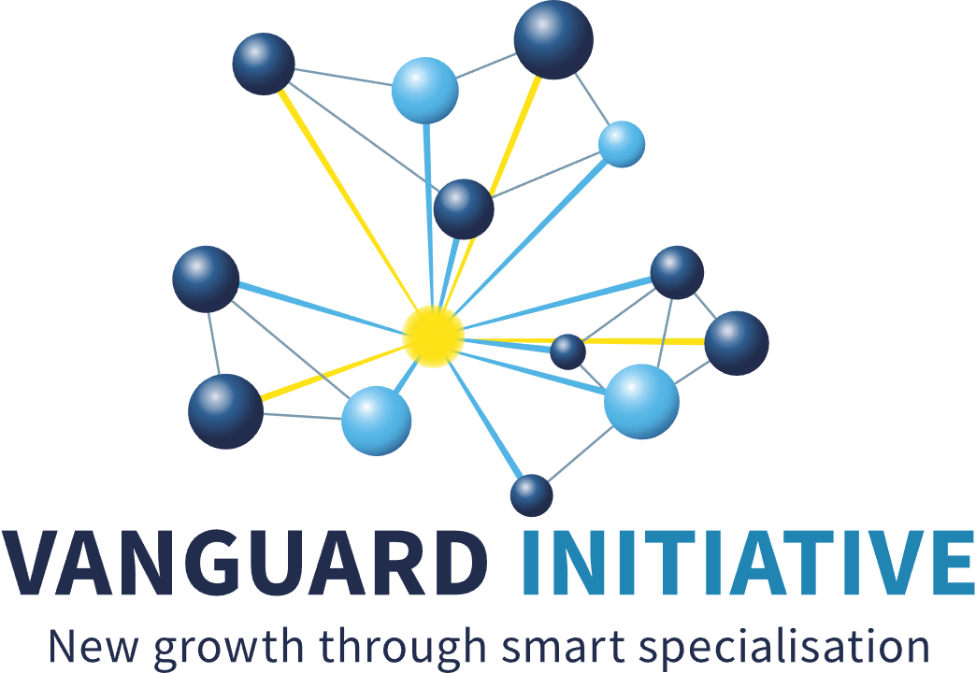
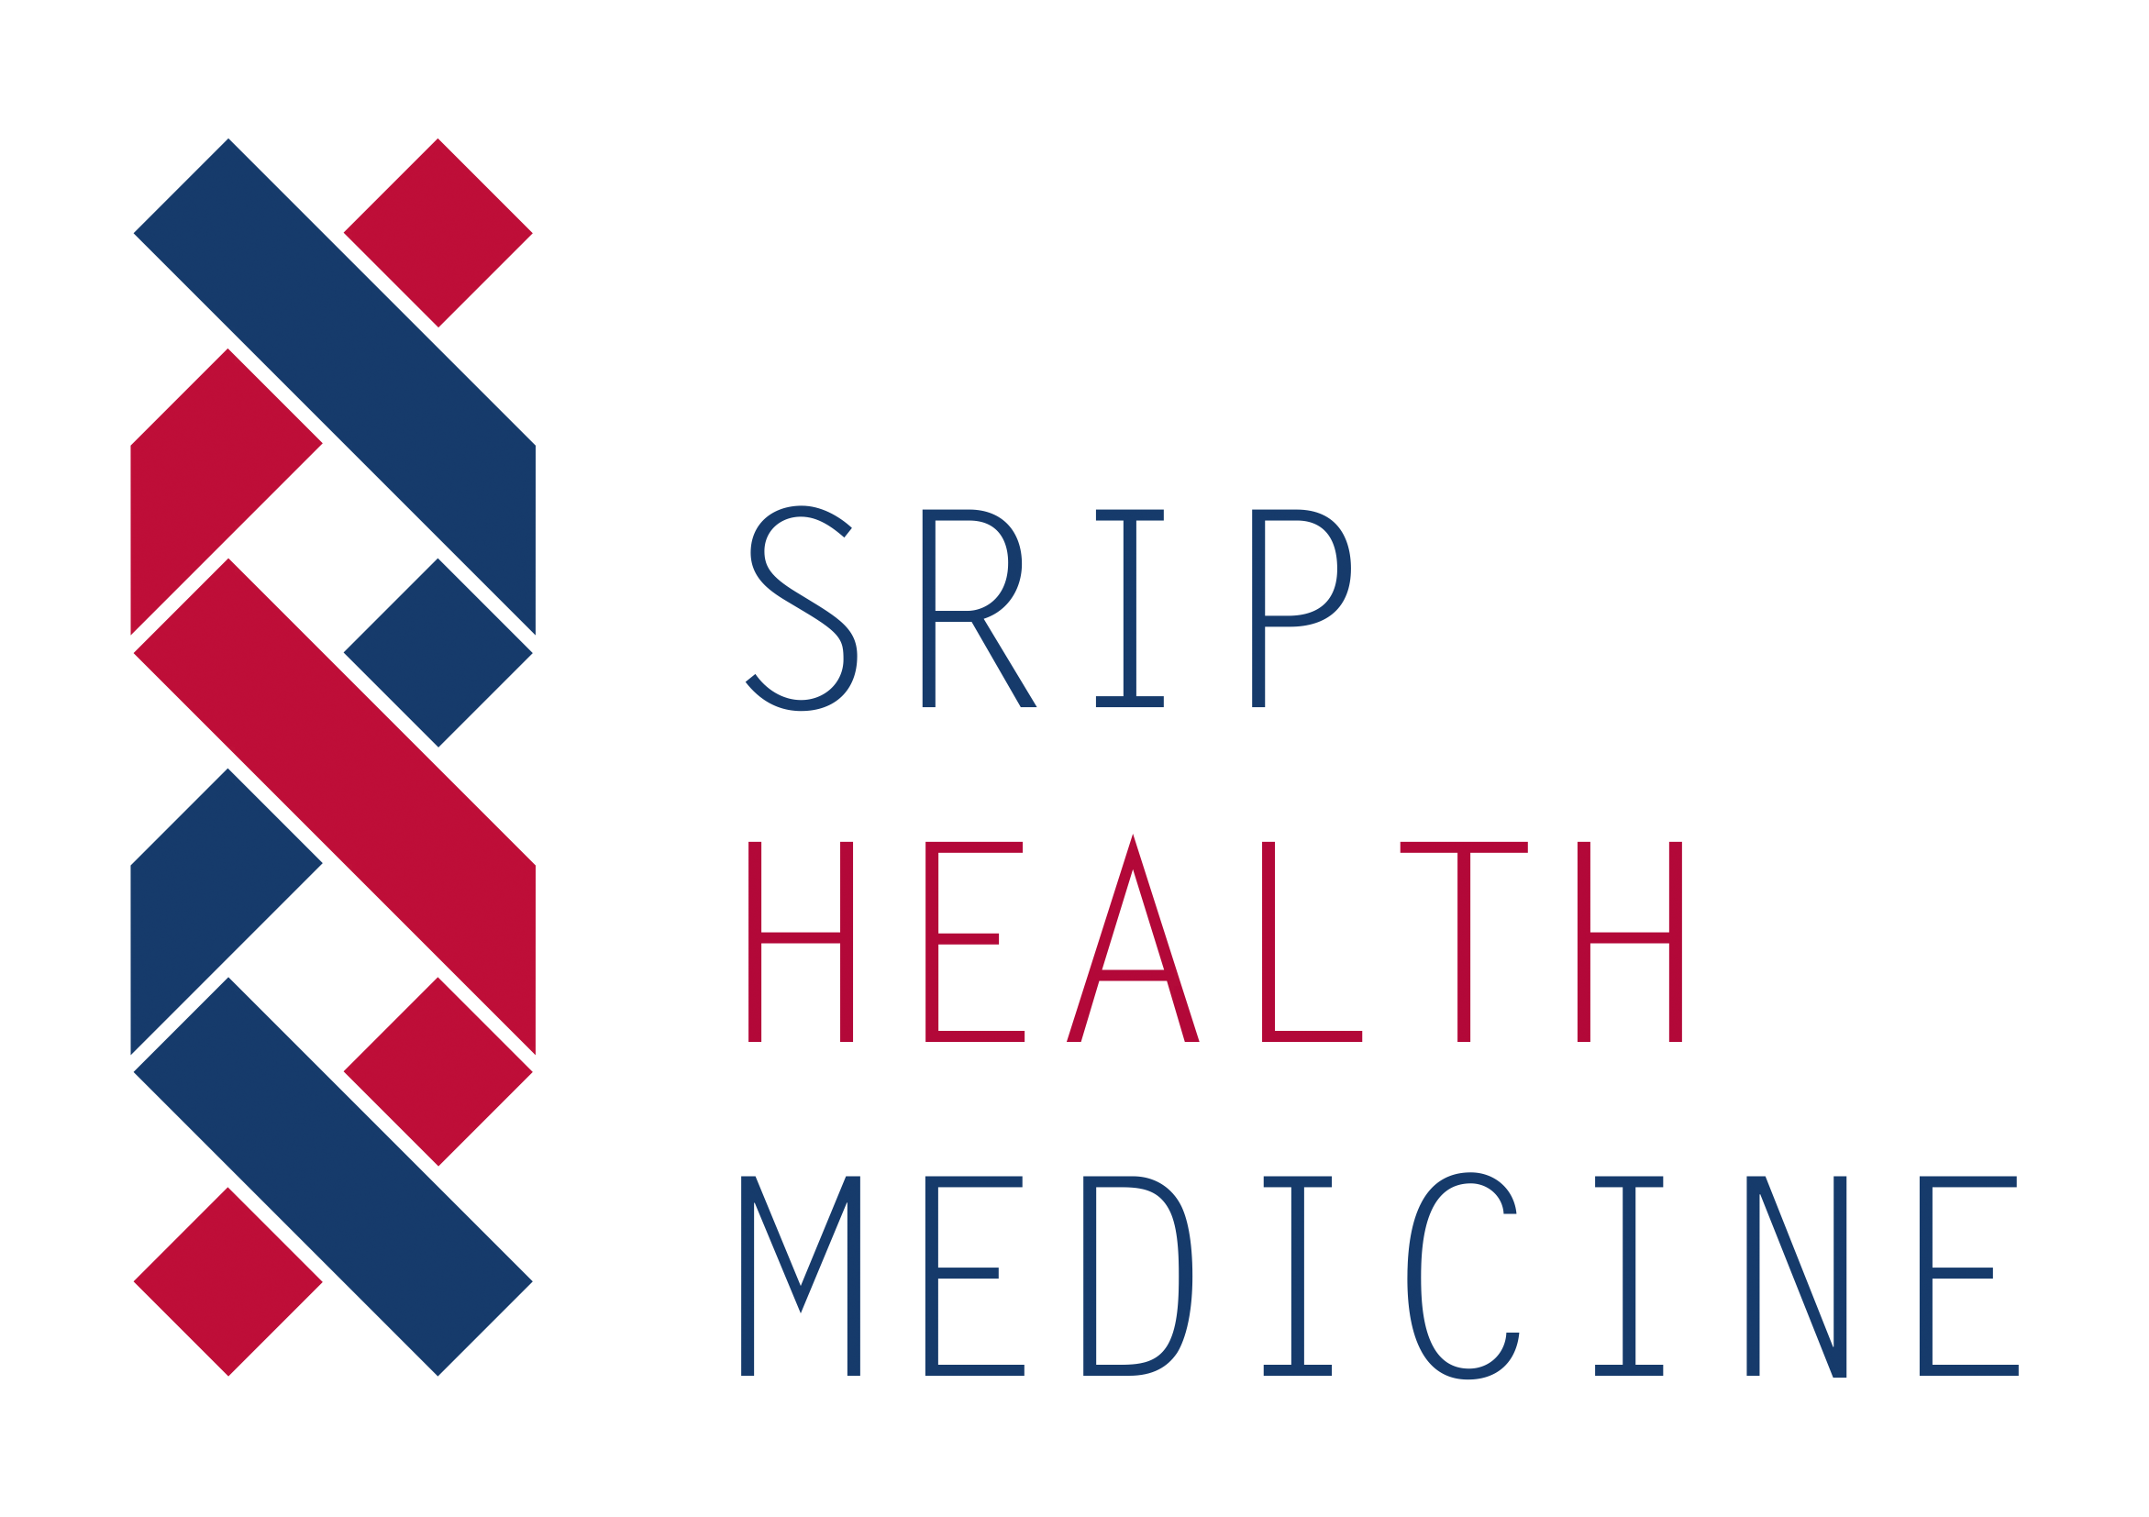
MOBILE HEALTH (R)EVOLUTION
Pilot project in Smart Health VI
Dr. Alenka Rožaj Brvar, MBA SIH EEIG
www.sis-egiz.eu

Slide 2
The story started in 2018 on one of the first meetings of S3P4PM platform, organized by Flemish Government, powerfully driven by Kathleen d’Hondt, and later by Jolien Roovers
S3 Partnership for the regional co-development, innovation and adoption of Personalised Medicine – translational needs
Slovenian Innovation Hub, dedicated to transferring innovation to the users, joined as the 4th partner of S3P4PM, the membership grew rapidly in the following years, in 2021 became Smart Health of VI

Slide 3
Slovenian Innovation Hub: active collaboration in international networks: TIM, RSCN, VI, EU projects
MHR solves: improper mngmt of chronic diseases, medication non-compliance, remote monitoring, triage, personalized education/prevention
Inividual, integrated, holistic approach – social innovation needed for successful implementation
By pharmacist supervised chronic disease self-management, and better adherence HC systems save a lot of capacities and money
Empowered=responsible patients, Q&safety of HC
Offered free access during COVID
SLO: 30% pharmacies
30% public health centres, 20% private
> 150.000 patients
> 2000 HC Professionals
Mobile Health (R)evolution – pilot VI
Advanced tools & advanced healthcare services for empowered and responsible patients

Slide 4
The importance of MHR TODAY
International initiatives EU projects
SafePolyMed - safety in polymedication
HealthChain – I3 shortening hospitalization after surgery, fast resocialization after hip replacement surgery
SelfManage+ - chronic disease mngmt platform, enriched role of pharmacists (new business model)
EarlyAI Assist – enabling cardiometabolic disease prevention via trustworthy AI predictive person centred models in the community - proposal
The importance of MHR TOMORROW
Supporting SI Mission Cancer program in SLO S5, safe, secure, documented remote collaboration with expert teams, education of patients, elderly and their caregivers, lowering social security costs, even better managing chronic diseases, powerful occupational disease management

Slide 5
Mobile Health Revolution is patient-centred affordable digital tool. It simplifies interactions between HC teams and individuals, enables faster rehabilitation and resocialization of older patients, monitoring and efficient management of chronic diseases, powerful occupational disease prevention, saves time and money to social care systems and to empowered responsible patients.

Slide 6
Thank you
Contact:
direktor@sis-egiz.eu
www.sis-egiz.eu
www.sripzdravje-medicina.si

